Slide 1
Agency Prepayment: Refinance
May 2016

Slide 2
Model Update Overview 1. Data Set
1
Modeling Refinances – A Three Step Process
In order to obtain Refinances from total prepayments, we need to subtract the Turnover, Default and Curtailment forecasts produced by the model:
Use a three step process to fit the multipliers for the Refinancing sub-model:
Use pre-2007 no-Media Effect data to build a baseline S-curve;
Use pre-2007 data to fit the Media Effect as a multiplier to the baseline S-Curve
Use the entire data set to fit all other multipliers (Credit Availability, WALA, burnout, loan size, CLTV etc.)
2
Pool Level Data Set
Consistent with our overall approach, we use pool level information to fit and track the refinance module.
The following pool level information is calculated using weighted-average loan level data:
Incentive, Burnout, Refi-Eligibility%, HARPed%
3
Data Updates and Model Extensions
Incentive: Incorporated cross-sector incentive (Conventional to FHA)
Burnout: Included LLPA and PMI when calculating relative incentive
Refi-Eligible %: Based on LLPA and PMI underwriting guidelines
Origination Channel: Using pool-level info on third party originations

Slide 3
Model Update Overview 2. Model Structure
Refinance model v1
Updates
3
1. Incorporate crossover incentive
Step Fitting Process
High LTV (>90%) conventional borrowers also have the option of refinancing into an FHA mortgage.
Use three cuts of the pool-level data set
2. Update Burnout with LLPA and PMI
When calculating the relative incentive, incorporate LLPA and PMI. Also, the calculation is performed at the loan-level.
7
3. Add Refi Eligibility flag
Parameters
Based on LLPA and PMI underwriting guidelines.
S Curve
Media Effect
Credit Availability
WALA
Burnout
Loan Size
CLTV
4. Add HARPed %
New parameter that measures the pool % that is HARPed. These borrowers tend to refi slower.
5. Add new CLTV curve for HARP eligible pools
Have two CLTV curves for normal mortgages and HARP eligible mortgages.
6. Add constraints for extrapolation
Using cap and floors for out of range extrapolation. Make sure the tail performance is reasonable.

Slide 4
Model Update Overview 2. Streamline Model Parameters
Refinance model v1
Refinance model v2
3
3
Step Fitting Process
Step Fitting Process
Using three data sets to get fitting for difference curves
Retain the 3 steps process in model v1
7
11
Parameters
Parameters
S Curve
Media Effect
Credit Availability
WALA
Burnout
Loan Size
CLTV
S Curve
Media Effect
Credit Availability
WALA
Burnout
Loan size
CLTV(Normal / HARP)
HARP-Eligible
Refi-Elig %
HARPed %
TPO %
1
Constraint
Constraints for extrapolation

Slide 5
Model Update Overview 2. Model Structure
3
Pre-2007
No-Media Effect
Data set
Base S Curve
Step Fitting Process
Retain the 3 steps process in model v1.
Pre-2007
Data set
Media Effect
11
Parameters
Entire Data set
Credit Availability
S Curve
Media Effect
Credit Availability
WALA
Burnout
Loan size
CLTV(Normal / HARP)
HARP-Eligible
Refi-Elig %
HARPed %
TPO %
Pool Characteristics:
WALA
Burnout
Loan size
CLTV
HARP-Elig
Refi-Elig %
HARPed %
TPO %
1
Constraint
Constraints for extrapolation

Slide 6
Data Preparation 1. Crossover Incentive – From Conventional to FHA
Q
uestion
Our current incentive calculation only measures the refinance incentive for conventional 30-year borrowers to refinance into another 30-year conventional mortgage. If so, how we can capture that?
P
roblem
Other than refinance into conventional programs, current conventional borrowers do have other choices, like refi into FHA loans.
A rational borrower will choose the program that offers the largest incentive.
Currently, as FHA doesn’t have a risk-based MIP, borrowers with poorer credit profiles (higher CLTV/lower FICO) have greater incentive to refinance into FHA loans.
S
olution
We separately calculate the incentive for a conventional loan to respectively refi into another conventional loan and an FHA loan.
The maximum of these two incentives corresponds to the “true” refinance incentive.

Slide 7
Data Preparation 1. Incentive – From Conventional to FHA
Incentive | = | Current Loan Cost | - | New Loan Cost
Conv. Incentive | = | (OrigNoteRate + PMI) | - | (PMMS + LLPA/4 + PMI)
FHA Incentive | = | (OrigNoteRate + PMI) | - | (FHA Mgt Rate + Upfront MIP/12 + Annual MIP)
Overall Incentive | = | Max ( Conv. Incentive, FHA Incentive)
2
Major Differences
1. Mortgage Rate
2. Risk-based Costs
LTV - Lower | LTV - Upper | 760+ | 740-759 | 720-739 | 700-719 | 680-699 | 660-679 | 640-659 | 620-639
95.01 | 97 | -.17 | .03 | .29 | .62 | .87 | 1.55 | 1.83 | 2.22
90.01 | 95 | -.44 | -.26 | -.05 | .21 | .48 | 1.07 | 1.28 | 1.51
85.01 | 90 | -.55 | -.44 | -.29 | -.06 | .13 | .65 | .83 | 1.00
0.01 | 85 | -.66 | -.65 | -.55 | -.39 | -.28 | .06 | .21 | .35
Conv-to-FHA Cost Difference (4/4/2016)

Slide 8
Data Preparation 1. Incentive – From Conventional to FHA
For generic FGLMC pools, we see that the FHA incentive is lower than the conventional incentive
FHA incentive increases with higher LTV. For 90-97% LTV, we see that FHA incentives are greater since 2013
For U6 pools, FHA incentives are much greater.
As FHA doesn’t have a risk based MIP, borrowers with poor profile(higher CLTV/lower FICO) has bigger incentive to refi into FHA loans

Slide 9
Data Preparation 2. Burnout – Including LLPA and PMI
Q
uestion
When we initially calculated burnout, we used the accumulated relative incentive. The relative incentive is defined as (OrigNoteRte / PMMS).
This calculation needs to take LLPA and PMI into consideration.
P
roblem
Need to re-calculate burnout on loan level
S
olution
We need to calculate relative incentive on loan level with LLPA and PMI
Calculate a loan-level weighted average to calculate pool burnout.

Slide 10
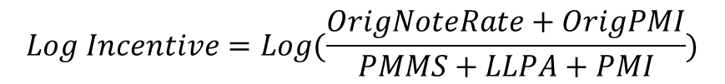
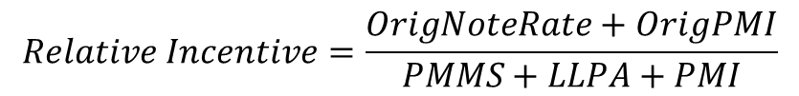
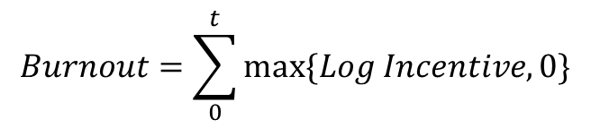
Data Preparation 2. Burnout – Including LLPA and PMI
Burnout in Model v1
Burnout in Model v2
Pool level relative incentive = WAC / PMMS
Special adjustments for when there’s a gap between loan age and pool age.
Weighted average of loan level relative incentive
Loan level relative incentive
= (OrigNoteRate + OrigPMI) / (PMMS + LLPA + PMI)
Use pool-level WAC / PMMS to fill the gap between loan origination date and the first factor date
Step 1
$$Relative Incentive=\frac{OrigNoteRate+OrigPMI}{PMMS+LLPA+PMI}$$
Step 2
$$Log Incentive=Log(\frac{OrigNoteRate+OrigPMI}{PMMS+LLPA+PMI})$$
$$Burnout=\sum_{0}^{t}{max⁡\{Log Incentive, 0\}}$$
Step 3
Step 4
$$Adjusted Burnout=Burnout+Origination Adj.$$

Slide 11
Data Preparation 2. Burnout – Including LLPA and PMI
For conventional pools, the updates don’t change aggregate burnout by much
The revised calculation is significantly lower for high LTV pools.

Slide 12
Data Preparation 3. Refinance Eligibility Flag
Q
uestion
The LLPA and PMI underwriting guidelines constrain the maximum CLTV and minimum FICO
How do we measure the number of loans that are not eligible to refinance?
P
roblem
Two practices we adopted in model v1 for ineligible mortgages are:
Assign the highest PMI / LLPA value in the underwriting matrix to these mortgages
Assign a very large number (like 999 bps) to the PMI/LLPA value to these mortgages
However, neither of these two is a good solution. Using maximum values is misleading in that loans that are ineligible for refinancing will see an incentive if mortgage rates fall enough. Using very large numbers causes problems at the pool-level when we calculate a loan-level weighted-average refinance incentive.
S
olution
Based on prevailing underwriting guidelines, we identify if each loan is eligible for refinancing or not.
The refinancing test is “global” in that it should apply across different mortgage products that a conventional borrower could theoretically refinance into (i.e., the refinance eligibility test shouldn’t just apply for refinancing into another 30-year conventional mortgage)

Slide 13
Data Preparation 3. Refinance Eligibility Flag
FNMA Upfront Loan-Level Price Adjustments |  |  |  |  | (AMDC of 0.25% & High LTV of 0.5% have been included)
 | LTV
Credit Score | <= 60 | 60.01-70 | 70.01-75 | 75.01-80 | 80.01-85 | 85.01-90 | 90.01-95 | 95.01-97 | >= 97.01
> 740 | 0.00 | 0.25 | 0.25 | 0.50 | 0.25 | 0.25 | 0.25 | 0.75 | Not Elig
720 - 739 | 0.00 | 0.25 | 0.50 | 0.75 | 0.50 | 0.50 | 0.50 | 1.00 | Not Elig
700 - 719 | 0.00 | 0.50 | 1.00 | 1.25 | 1.00 | 1.00 | 1.00 | 1.50 | Not Elig
680 - 699 | 0.00 | 0.50 | 1.25 | 1.75 | 1.50 | 1.25 | 1.25 | 1.50 | Not Elig
660 - 679 | 0.00 | 1.00 | 2.25 | 2.75 | 2.75 | 2.25 | 2.25 | 2.25 | Not Elig
640 - 659 | 0.50 | 1.25 | 2.75 | 3.00 | 3.25 | 2.75 | 2.75 | 2.75 | Not Elig
620 - 639 | 0.50 | 1.50 | 3.00 | 3.00 | 3.25 | 3.25 | 3.25 | 3.50 | Not Elig
< 620 | Not Elig | Not Elig | Not Elig | Not Elig | Not Elig | Not Elig | Not Elig | Not Elig | Not Elig
Product Feature (Cumulative)
Investment Property | 2.125 | 2.125 | 2.125 | 3.375 | 4.125 | Not Elig | Not Elig | Not Elig | Not Elig
2 Unit Property | 1.00 | 1.00 | 1.00 | 1.00 | 1.00 | Not Elig | Not Elig | Not Elig | Not Elig
Condominiums | 0.00 | 0.00 | 0.00 | 0.75 | 0.75 | 0.75 | 0.75 | 0.75 | Not Elig
Loan Size > 417K | 0.25 | 0.25 | 0.25 | 0.25 | 0.25 | Not Elig | Not Elig | Not Elig | Not Elig
Based on loan level information, we determine whether a borrower is eligible to refinance under current underwriting guidelines. This flag is time-dependent in that underwriting guidelines vary over time.
We then calculate the loan-level weighted average for each pool.
Pools originated before 2009-06 are 100% Refinance Eligible after 2009-06 because of the HARP program
Note that treating a pool like a loan and calculating a refi-eligible flag is not practical. For example, a pool with an LTV of 96% would technically be 100% Refinance Eligible even though there may be several loans with LTVs > 97%.

Slide 14
Data Preparation 3. Refinance Eligibility Flag
Refi-eligible percentage for conventional pools experienced a 5% decrease from 2009 to 2014.
When U6 pools get originated, all of them have OLTV greater than 97%. So in that case 0% of the balance is eligible to refi.
As loan ages increase, CLTV typically decreases. Around 50% of these loans are eligible to refi by now.

Slide 15
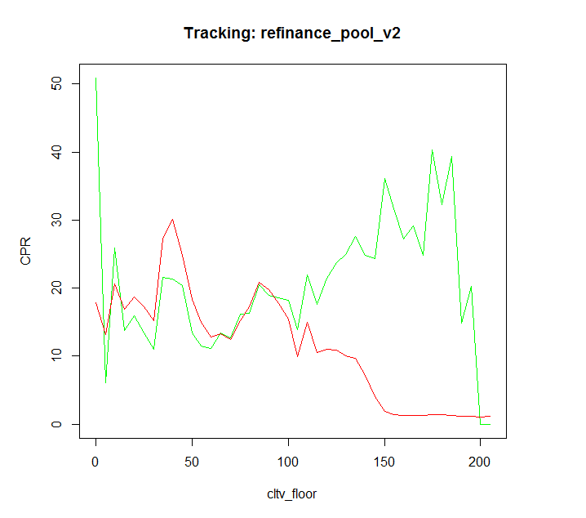
Data Preparation 4. CLTV Curve for HARP Eligible Mortgages
Q
uestion
In general it is harder for mortgages to refinance when their CLTVs go up. However, this pattern doesn’t apply to HARP-eligible mortgages.
So, how can we capture the difference between normal mortgages and HARP eligible mortgages?
P
roblem
Borrowers with very high CLTVs have difficultly refinancing but HARP eligible borrowers appear to behave differently -- they refinance faster at higher CLTVs.
HARP eligible is a binary factor for the mode; linking it directly as a multiplier rescales the normal CLTV curve. However, given the opposing pattern of prepayment behavior as a function of CLTV for HARP and non-HARP eligible borrowers, this rescaling leads to significant distortions.
CLTV Tracking
S
olution
We use the HARP eligibility as a switch and build two CLTV curves.
CLTV Curve 1: calibrate and apply on normal mortgages
CLTV Curve 2: calibrate and apply on HARP eligible mortgages
When a pool is HARP eligible, choose CLTV curve 2, otherwise use CLTV curve 1.

Slide 16
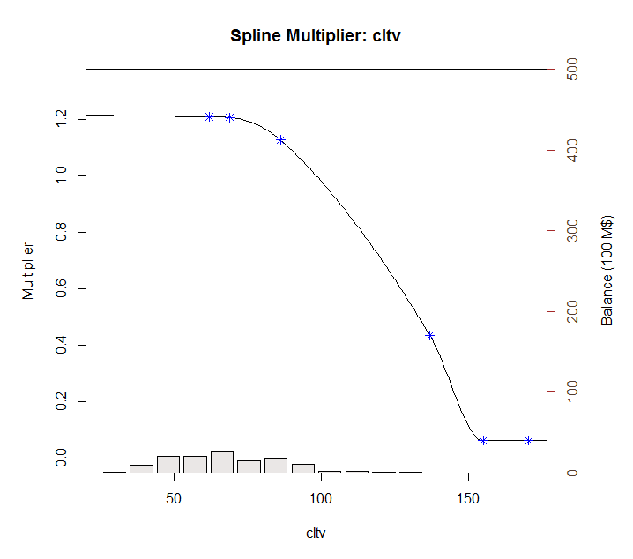
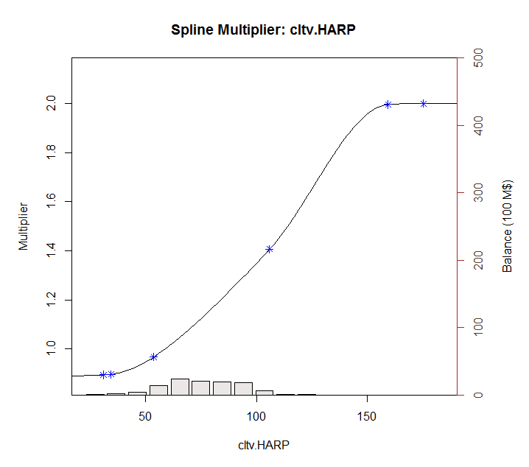
Data Preparation 4. CLTV Curve for HARP Eligible Mortgages
Not eligible for HARP
Check origination date:
If originated before 2009-06
Eligible for HARP
Notice the difference in behavior by the two groups.

Slide 17
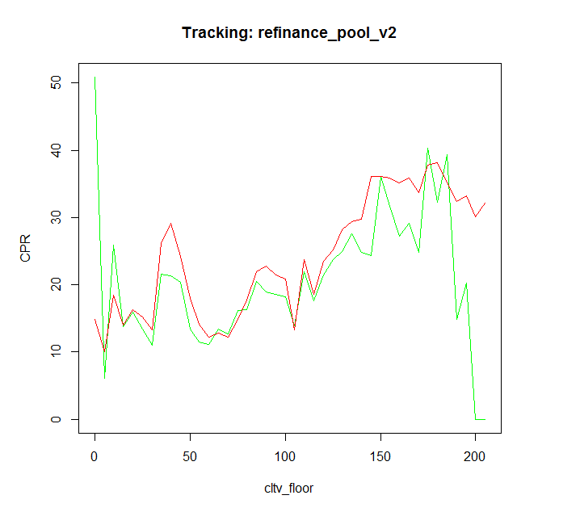
Data Preparation 4. CLTV Curve for HARP Eligible Mortgages
Using One CLTV Curve
Using Two CLTV Curves
And HARP Eligible Factor

Slide 18
v2 Refinance Model Details 1. Model Multipliers
S-Curve | The baseline curve is built based on the pre-2007 no-media-effect period. Incentive is the max of Conventional and FHA Incentive.
Media Effect | Using Refinanceable Universe as Media Effect. Curve is calibrated based on pre-2007 data.
Credit Availability | HPA 2yr MA. Higher levels of HPA are correlated with greater mortgage credit availability.
WALA | Short seasoning ramp for refinancings
Burnout | Cumulative incentive in a loan’s life time.
Loan Size | Large size loans will refi faster than loans with smaller balances.
CLTV | Borrowers with higher LTVs are less likely to refinance. However, the HARP program made it possible for even very high LTV loans to refinance
Refi Elig % | The percentage of a pool’s balance that is eligible to refinance.
HARPed % | HARPed loans are more difficult to refi compared to Purchase loans originated over the same time period
Origination Channel | Third party-originated loans refinance faster
v2 of the Refinance model includes the 10 prediction parameters listed above.
Sequentially fitting model with the 10 parameters, we can create a cubic spline curve for each one of these inputs.
The parameter ordering is based on a single parameter regression calculated R-square value.
Parameters that have earlier order will have more significant impact on our model output.

Slide 19
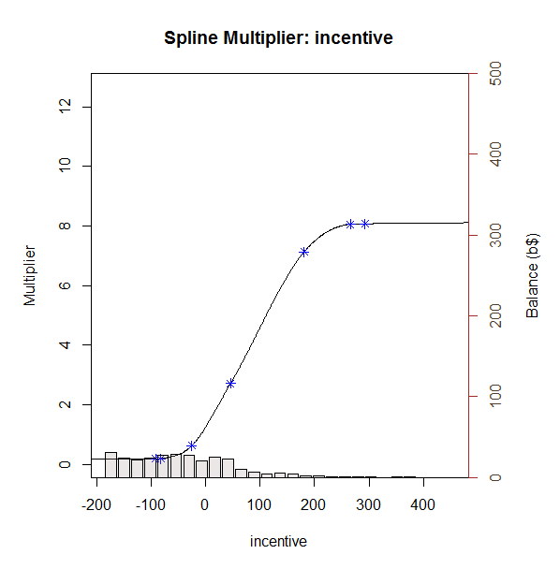
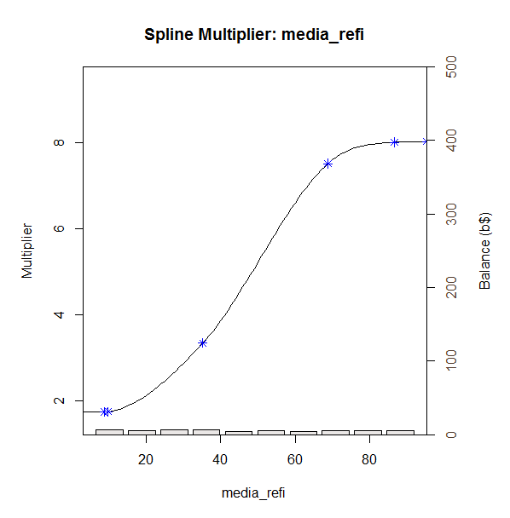
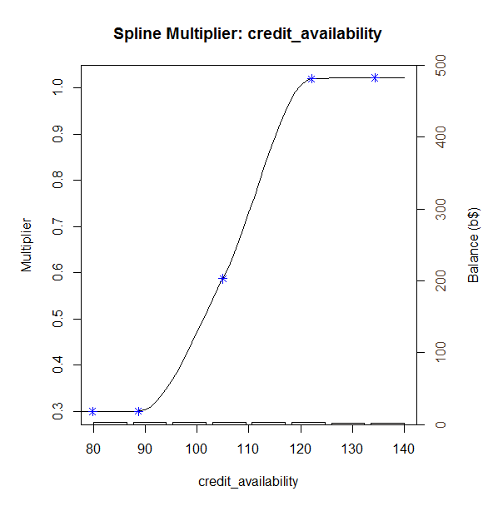
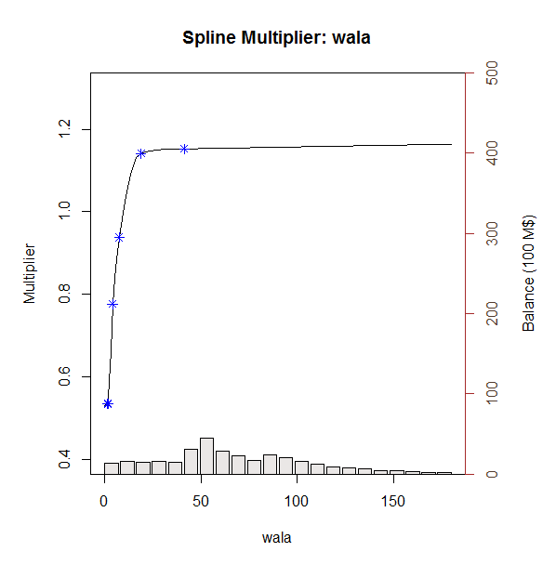
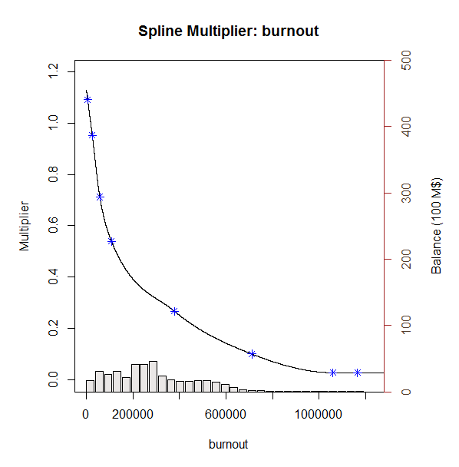
v2 Refinance Model Details 2. Model Multiplier Splines

Slide 20
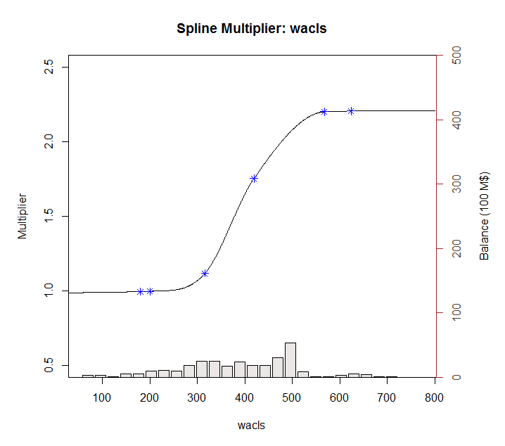
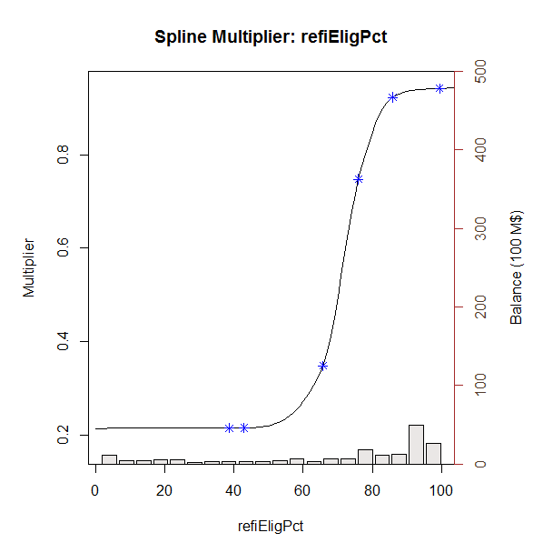
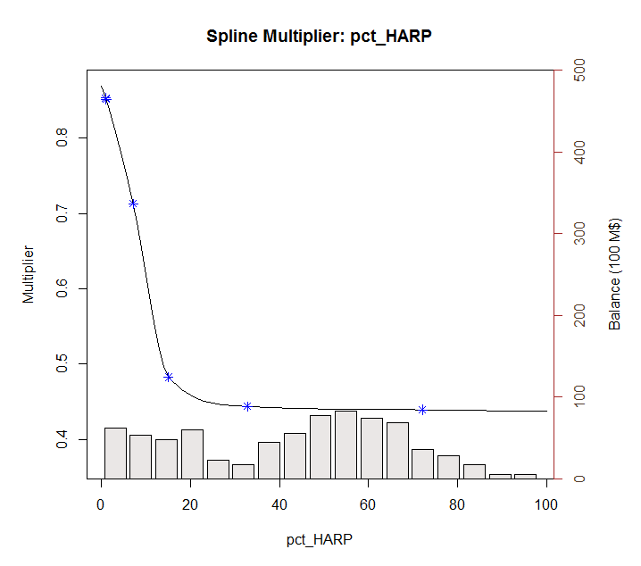
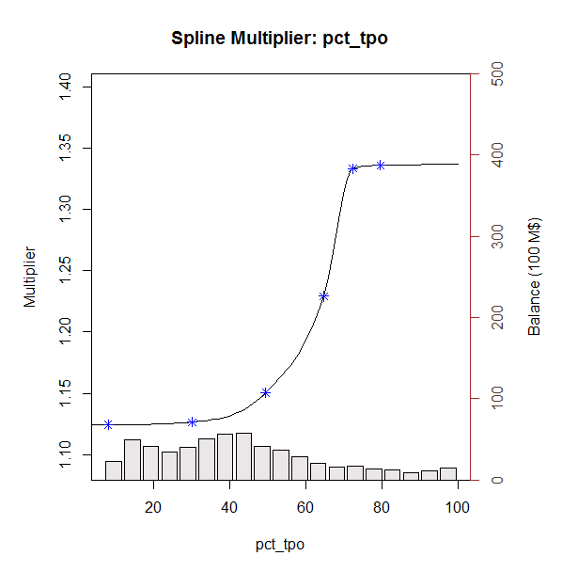
v2 Refinance Model Details 2. Model Multiplier Splines

Slide 21
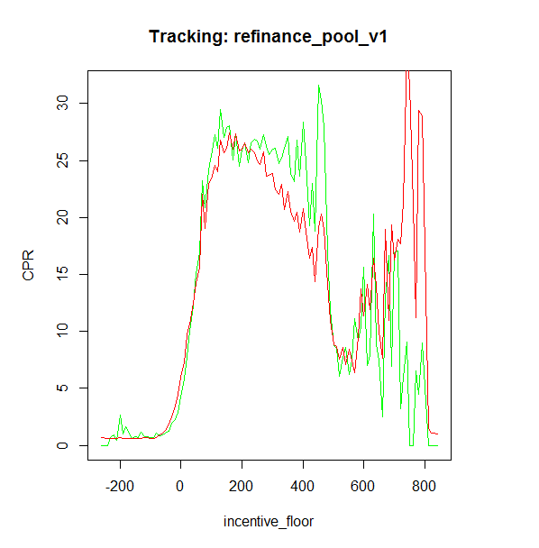
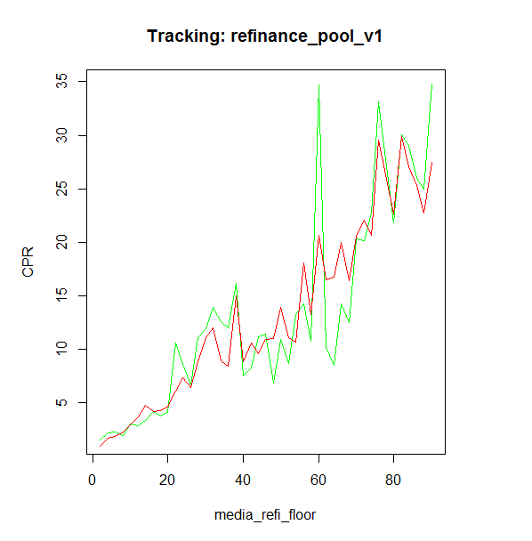
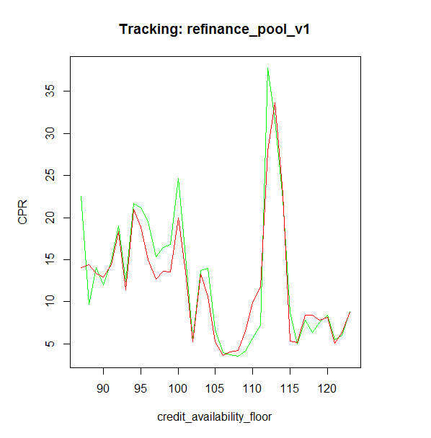
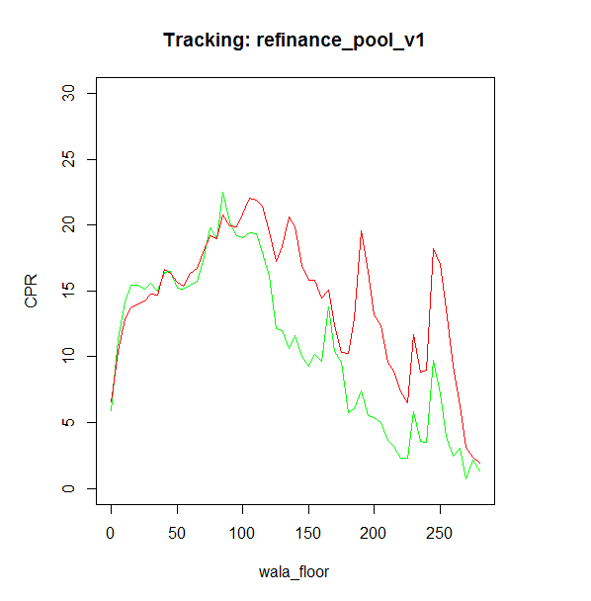
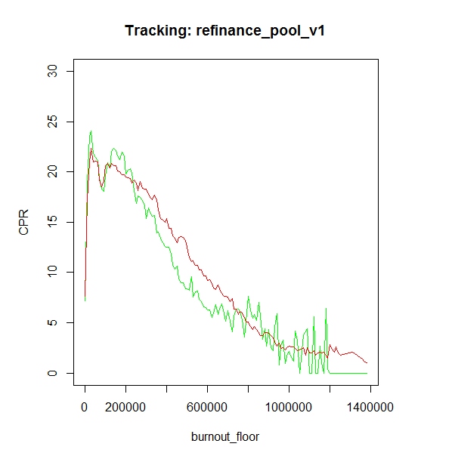
v2 Refinance Model Details 3. Model Multiplier Tracking
Actual
Model

Slide 22
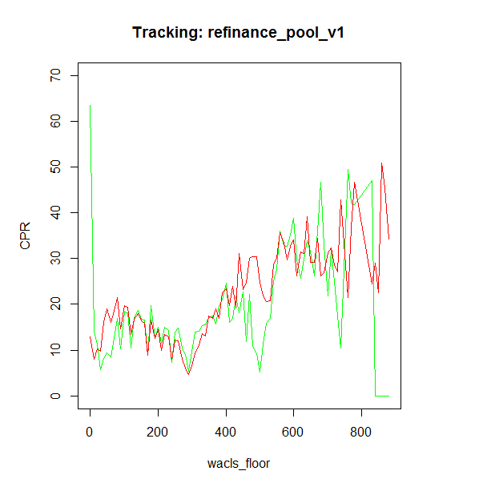
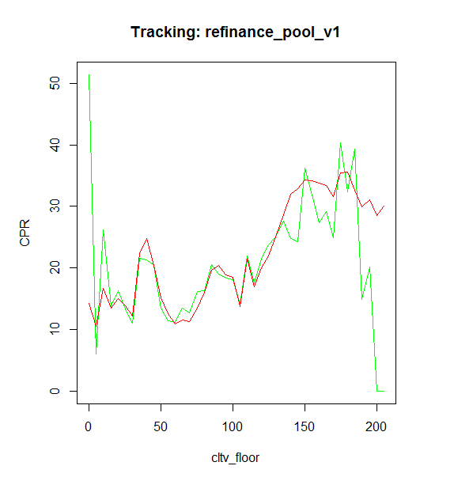
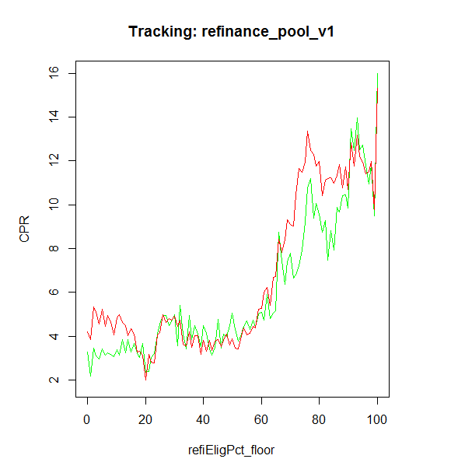
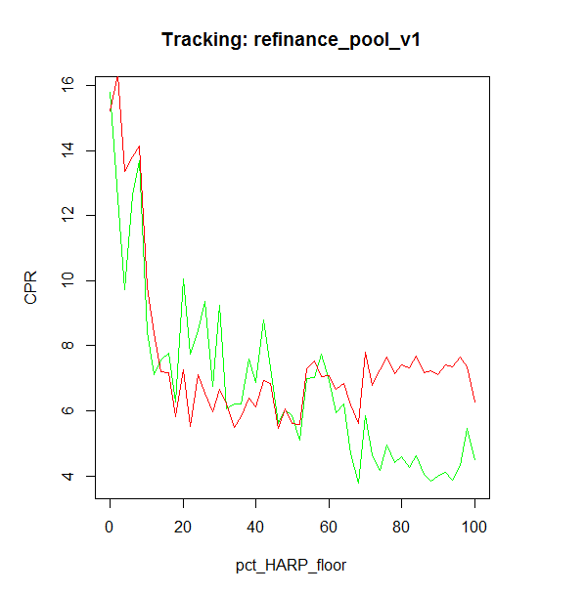
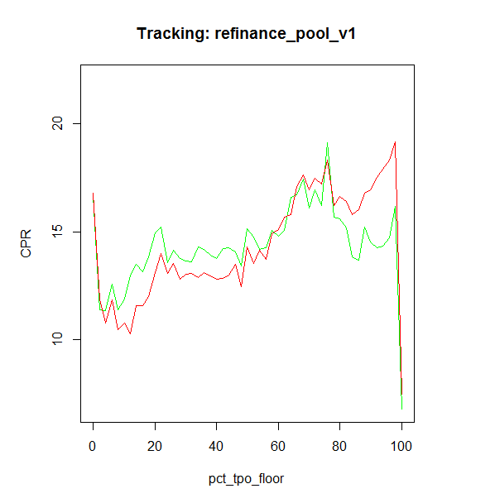
v2 Refinance Model Details 3. Model Multiplier Tracking
Actual
Model

Slide 23
v2 Refinance Model Details 3. Performance Comparison
Conventional pool tracking shows v2 has smaller tracking error.
Jumbo pools tracking for post 2014 looks faster for v2 than v1
CQ pool tracking is more reliable now, as we fixed the incentive calculation for HARPed loans.
Similar as CQs. V2 model shows better performance for CRs

Slide 24
Appendix 1. Max Value of Multipliers
 | Min | Max
baselineConstant | 1.86
incentive | 0.19 | 8.08
media | 1.75 | 8.02
creditAvailability | 0.30 | 1.02
burnout | 0.03 | 1.09
wacls | 0.99 | 2.33
cltv | 1.02 | 1.94
refiElig | 0.21 | 0.94
pct_HARP | 0.45 | 0.87
pct_tpo | 1.12 | 1.34
Multiplier | 0.00 | 358.71

Slide 25
Appendix 2. Further Research
Dispersion Between MCAI and HPA2Yr
In our current model, we use HPA two-year moving average as a measure of market credit availability. However, comparing the Mortgage Credit Availability Index and HPA2Yr curves, we can see a dispersion between them after 2013. At the same time, our model tracking error goes up.
We might want to change the credit availability measure in our future version of model. MCAI would be a choice. In that case, since the MCAI is calculated by the origination information of all kinds of loan products(including non-agency products), we need to actively maintain the market share of different products.

Slide 26
Appendix 2. Further Research
Dispersion Between MCAI and HPA2Yr
In our current model, we use HPA two-year moving average as a measure of market credit availability. However, comparing the Mortgage Credit Availability Index and HPA2Yr curves, we can see a dispersion between them after 2013. At the same time, our model tracing error goes up.
We might want to change the credit availability measure in our future version of model. MCAI would be a choice. In that case, since the MCAI is calculated by the origination information of all kinds of loan products(including non-agency products), we need to actively maintain the market share of different products.

Slide 27
Appendix 3. Further Research – To-Do List
Burnout: Incorporate FHA Incentive in measuring incentive
Burnout: Backfill history for seasoned loans using LLPA and PMI (recall that OLTV is available at the loan-level)
Refi Eligibility: Ensure that this is a global flag – i.e., it measures the eligibility of a loan to refinance into any mortgage program
Refi Eligibility: Are we capturing the ability of high-balance loans to refinance into an FHA Jumbo mortgage?
MCAI: Refit MCAI multiplier using MBA MCAI (2-year moving average). Also try Cello MCAI.

